Slide 1
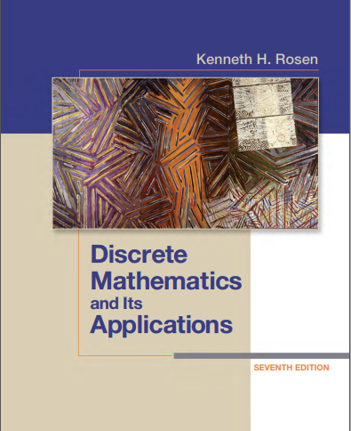

Discrete structures
By Dr. sajid iqbal
Course Reference Book

Slide 2
Methods of proofs
Chapter - 1

Slide 3
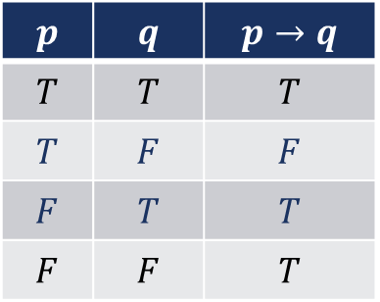
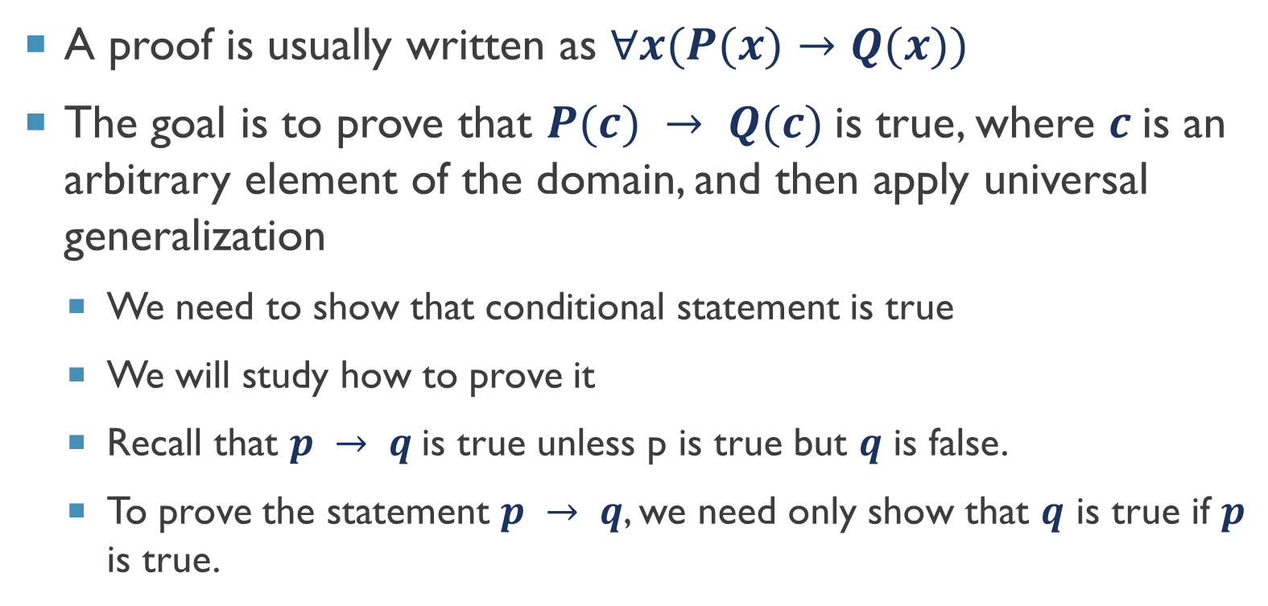
Back ground
A proof is usually written as $∀x(P(x)→Q(x))$
The goal is to prove that $P(c) → Q(c)$is true, where $c$is an arbitrary element of the domain, and then apply universal generalization
We need to show that conditional statement is true
We will study how to prove it
Recall that $p → q$is true unless p is true but $q$ is false.
To prove the statement $p → q$, we need only show that $q$ is true if $p$ is true.

Slide 4
Methods of Proofs
Director Proofs
Proof by Contraposition
Proof by Contradiction

Slide 5
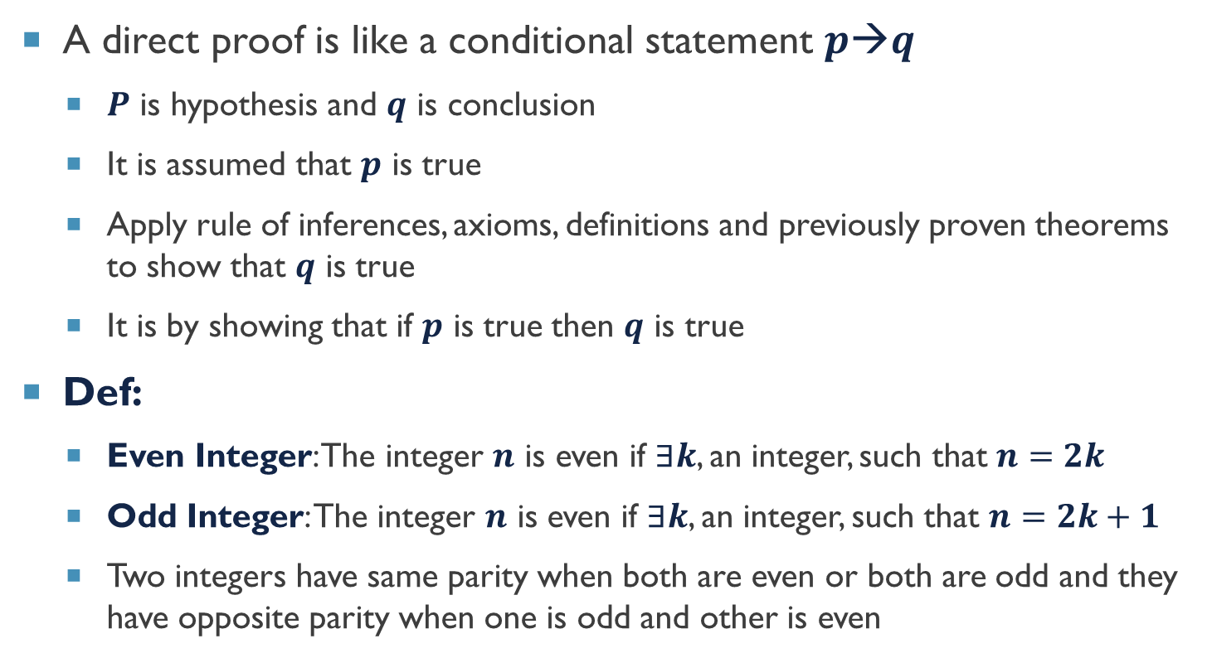
Direct proof
A direct proof is like a conditional statement $p→q$
$P$ is hypothesis and $q$ is conclusion
It is assumed that $p$ is true
Apply rule of inferences, axioms, definitions and previously proven theorems to show that $q$ is true
It is by showing that if $p$ is true then $q$ is true
Def:
Even Integer: The integer $n$ is even if $∃k$, an integer, such that $n=2k$
Odd Integer: The integer $n$ is even if $∃k$, an integer, such that $n=2k+1$
Two integers have same parity when both are even or both are odd and they have opposite parity when one is odd and other is even
$$p$$ | $$q$$ | $$p→q$$
$$T$$ | $$T$$ | $$T$$
$$T$$ | $$F$$ | $$F$$
$$F$$ | $$T$$ | $$T$$
$$F$$ | $$F$$ | $$T$$

Slide 6
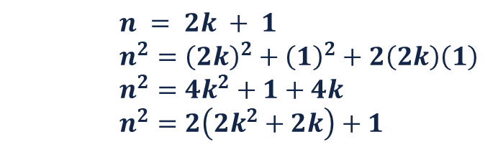
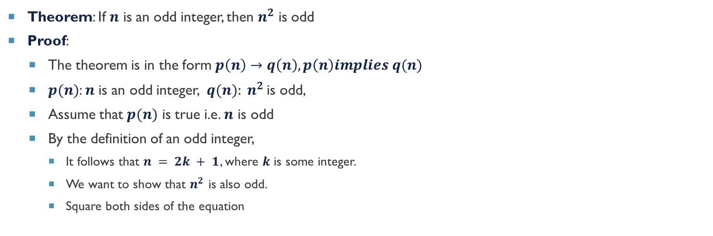
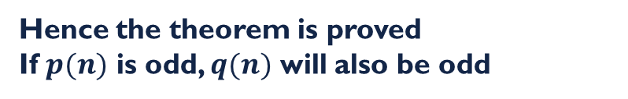

Example - Direct proof
Theorem: If $n$ is an odd integer, then $n^{2}$ is odd
Proof:
The theorem is in the form $p\left(n\right)→q\left(n\right), p\left(n\right)implies q(n)$
$p(n)$: $n$ is an odd integer, $q(n): n^{2}$is odd,
Assume that $p(n)$ is true i.e. $n$ is odd
By the definition of an odd integer,
It follows that $n = 2k + 1$, where $k$ is some integer.
We want to show that $n^{2}$ is also odd.
Square both sides of the equation
$$n = 2k + 1$$
$$n^{2}={\left(2k\right)}^{2}+{\left(1\right)}^{2}+2\left(2k\right)\left(1\right)$$
$$n^{2}=4k^{2}+1+4k$$
$$n^{2}=2\left(2k^{2}+2k\right)+1$$
Axiom: 2(n) is even, whether n is even or odd therefore
$$n^{2}=2\left(2k^{2}+2k\right)+1$$
$$n^{2}=even+1$$
$$n^{2}=odd$$
Hence the theorem is proved
If $p(n)$ is odd, $q(n)$ will also be odd

Slide 7

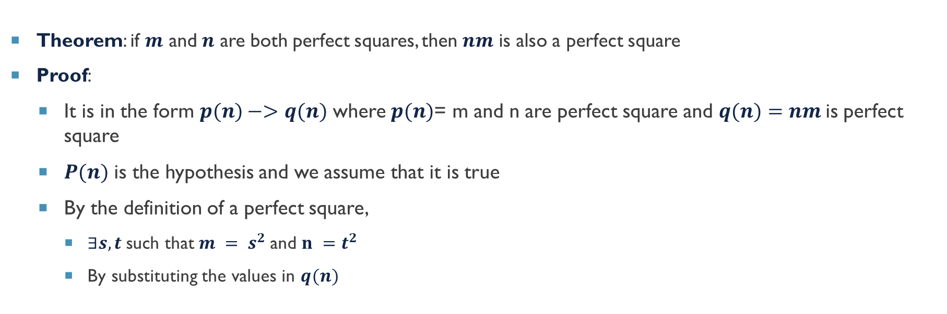
Example – Direct Proof
Theorem: if $m$ and $n$ are both perfect squares, then $nm$ is also a perfect square
Proof:
It is in the form $p(n)−>q(n)$ where $p(n)$= m and n are perfect square and $q(n)=nm$is perfect square
$P(n)$ is the hypothesis and we assume that it is true
By the definition of a perfect square,
$∃s,t$such that$m = s^{2}$and $n =t^{2}$
By substituting the values in $q(n)$
$$mn=s^{2}t^{2}$$
$$mn={\left(st\right)}^{2}$$
$$nm={\left(st\right)}^{2}$$
using commutativity and associativity of multiplication

Slide 8
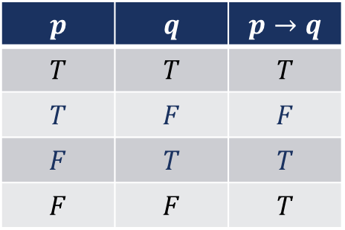
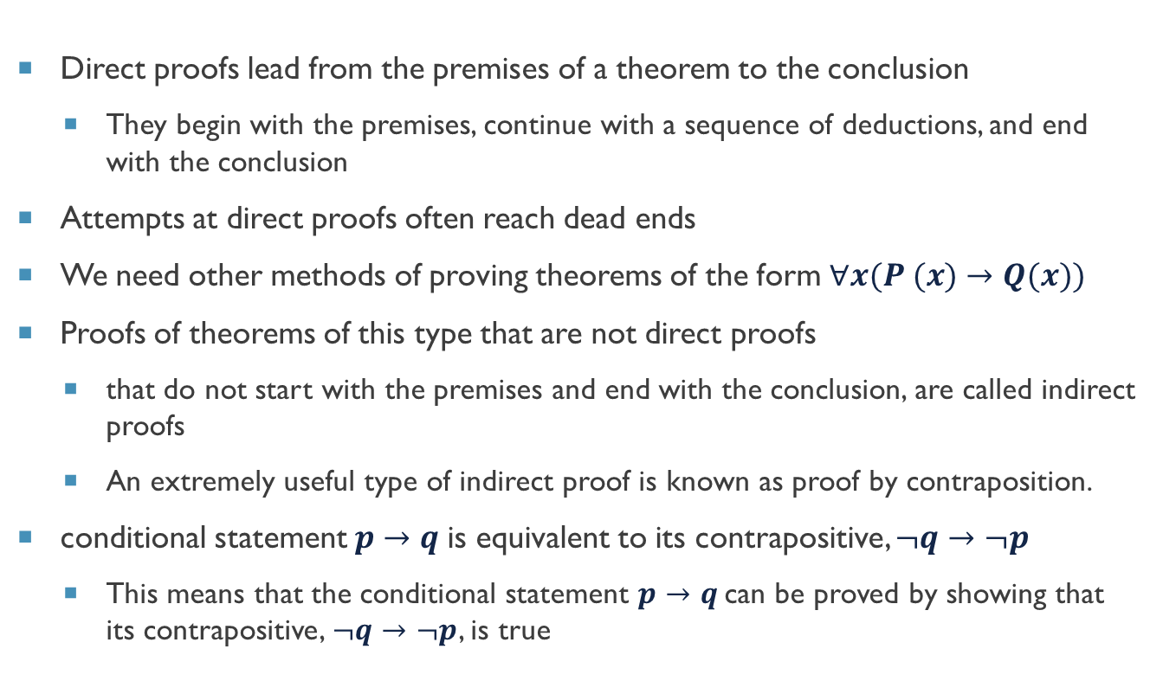
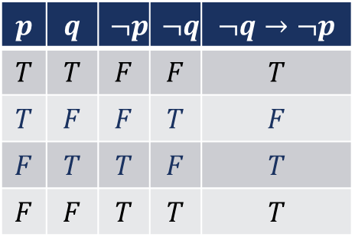
Proof by contraposition
Direct proofs lead from the premises of a theorem to the conclusion
They begin with the premises, continue with a sequence of deductions, and end with the conclusion
Attempts at direct proofs often reach dead ends
We need other methods of proving theorems of the form $∀x(P (x)→Q(x))$
Proofs of theorems of this type that are not direct proofs
that do not start with the premises and end with the conclusion, are called indirect proofs
An extremely useful type of indirect proof is known as proof by contraposition.
conditional statement $p→q$is equivalent to its contrapositive, $¬q→¬p$
This means that the conditional statement $p→q$can be proved by showing that its contrapositive, $¬q→¬p$, is true
$$p$$ | $$q$$ | $$p→q$$
$$T$$ | $$T$$ | $$T$$
$$T$$ | $$F$$ | $$F$$
$$F$$ | $$T$$ | $$T$$
$$F$$ | $$F$$ | $$T$$
$$p$$ | $$q$$ | $$¬p$$ | $$¬q$$ | $$¬q→¬p$$
$$T$$ | $$T$$ | $$F$$ | $$F$$ | $$T$$
$$T$$ | $$F$$ | $$F$$ | $$T$$ | $$F$$
$$F$$ | $$T$$ | $$T$$ | $$F$$ | $$T$$
$$F$$ | $$F$$ | $$T$$ | $$T$$ | $$T$$

Slide 9
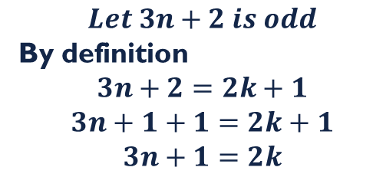
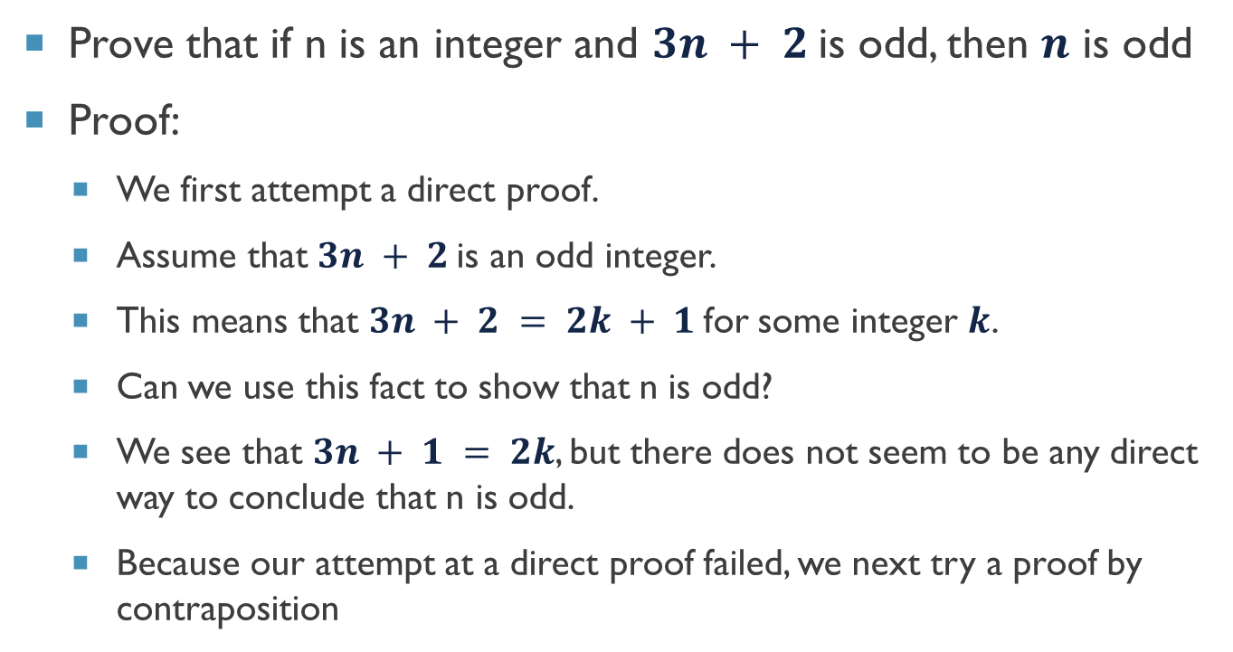
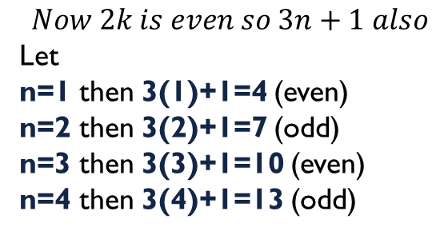
Example – Proof by contrapositive
Prove that if n is an integer and $3n + 2$is odd, then $n$ is odd
Proof:
We first attempt a direct proof.
Assume that $3n + 2$is an odd integer.
This means that $3n + 2 = 2k + 1$for some integer $k$.
Can we use this fact to show that n is odd?
We see that $3n + 1 = 2k$, but there does not seem to be any direct way to conclude that n is odd.
Because our attempt at a direct proof failed, we next try a proof by contraposition
$$Let 3n+2 is odd$$
By definition
$$3n+2=2k+1$$
$$3n+1+1=2k+1$$
$$3n+1=2k$$
$$Now 2k is even so 3n+1 also$$
Let
n=1 then 3(1)+1=4 (even)
n=2 then 3(2)+1=7 (odd)
n=3 then 3(3)+1=10 (even)
n=4 then 3(4)+1=13 (odd)

Slide 10
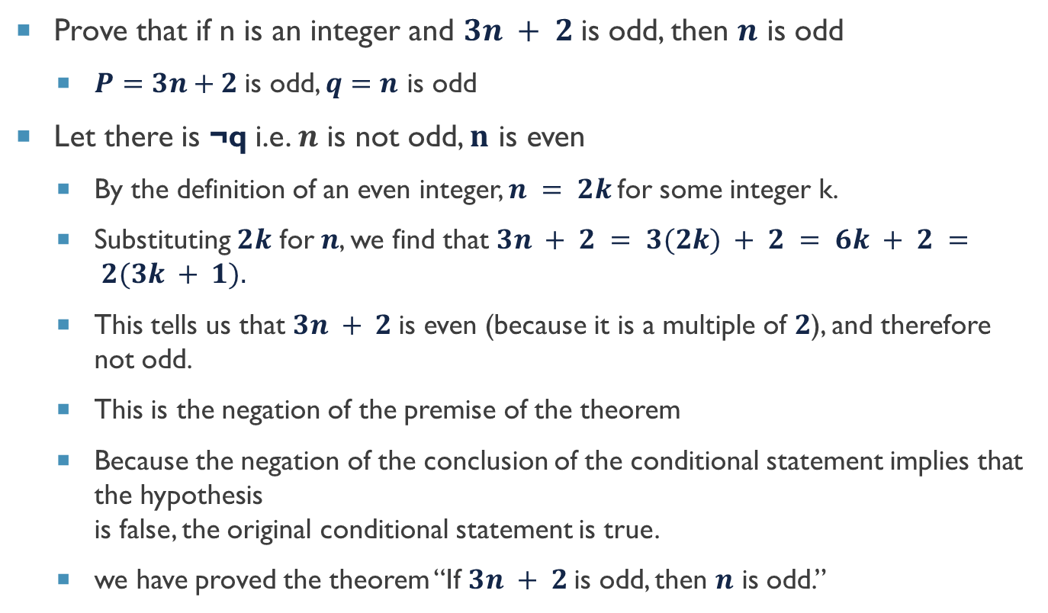

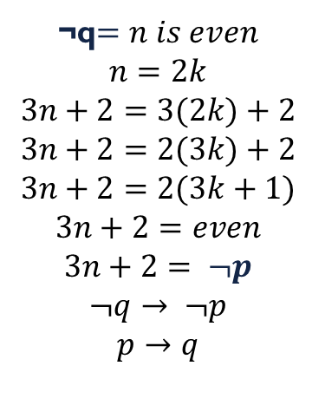
Example – proof by contraposition ($¬q→¬p$)
Prove that if n is an integer and $3n + 2$is odd, then $n$ is odd
$P=3n+2$is odd, $q=n$ is odd
Let there is ¬q i.e. $n$ is not odd, $n$ is even
By the definition of an even integer, $n = 2k$for some integer k.
Substituting $2k$ for $n$, we find that $3n + 2 = 3(2k) + 2 = 6k + 2 = 2(3k + 1).$
This tells us that $3n + 2$is even (because it is a multiple of $2$), and therefore not odd.
This is the negation of the premise of the theorem
Because the negation of the conclusion of the conditional statement implies that the hypothesis is false, the original conditional statement is true.
we have proved the theorem “If $3n + 2$is odd, then $n$ is odd.”
¬q$=n is even$
$$n=2k$$
$$3n+2=3(2k)+2$$
$$3n+2=2(3k)+2$$
$$3n+2=2(3k+1)$$
$$3n+2=even$$
$$3n+2= ¬p$$
$$¬q→ ¬p$$
$$p→q$$

Slide 11
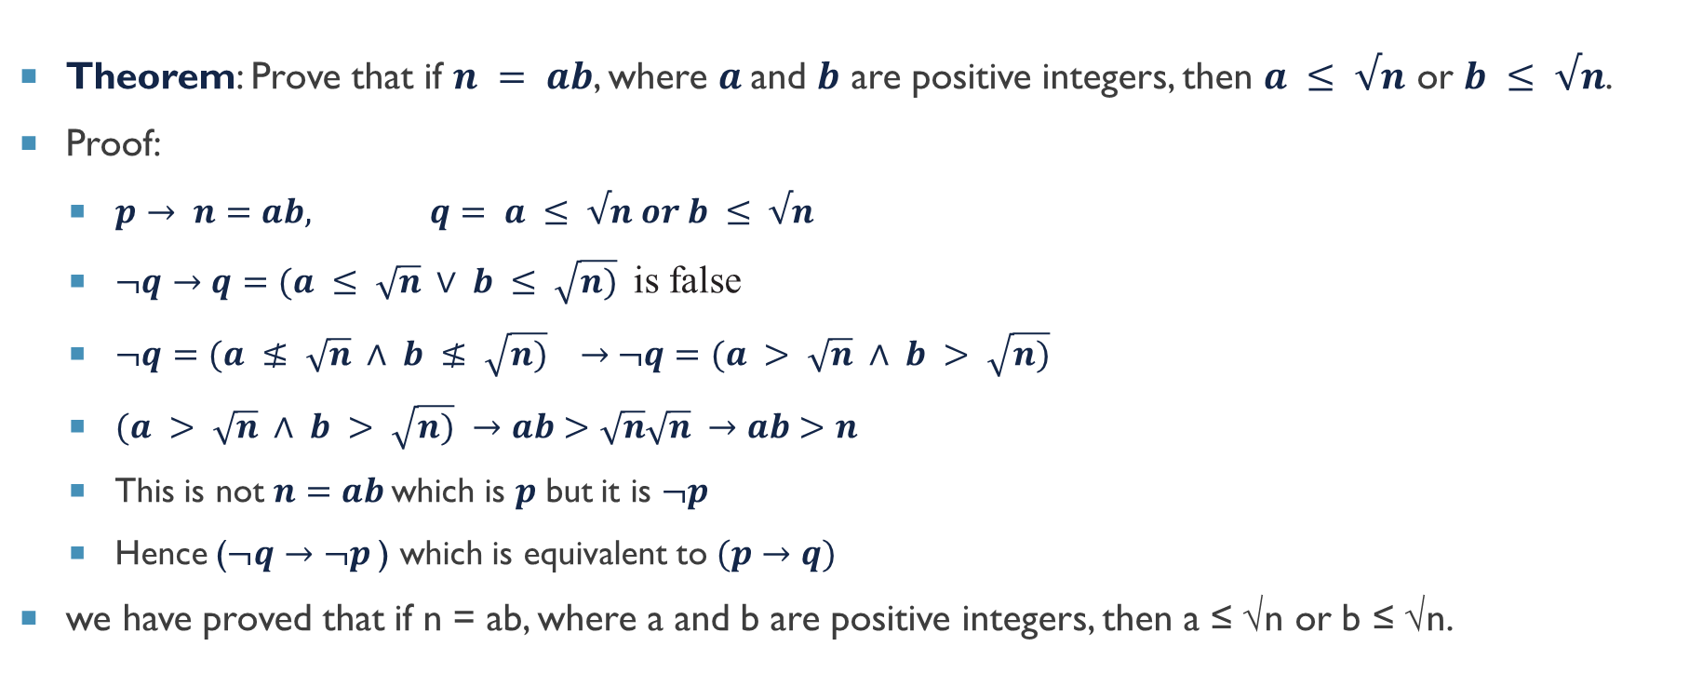

Example – Contraposition ($¬q→¬p$)
Theorem: Prove that if $n = ab$, where $a$and $b$ are positive integers, then $a ≤ √n$ or $b ≤ √n$.
Proof:
$p→ n=ab, q= a ≤ √n or b ≤ √n$
$¬q→q=(a ≤ \sqrt{n} ∨ b ≤ \sqrt{n)}$ is false
$¬q=(a ≰ \sqrt{n} ∧ b ≰ \sqrt{n)} →$ $¬q=(a > \sqrt{n} ∧ b > \sqrt{n)}$
$(a > \sqrt{n} ∧ b > \sqrt{n)} →ab>\sqrt{n}\sqrt{n} →ab>n$
This is not $n=ab$which is $p$ but it is $¬p$
Hence ($¬q→¬p$) which is equivalent to $(p→q)$
we have proved that if n = ab, where a and b are positive integers, then a ≤ √n or b ≤ √n.
Using the meaning of disjunction together with De Morgan’s law,

Slide 12
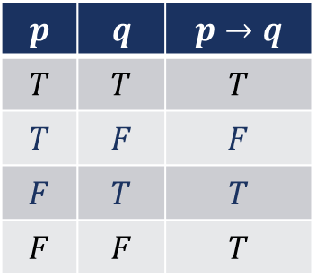
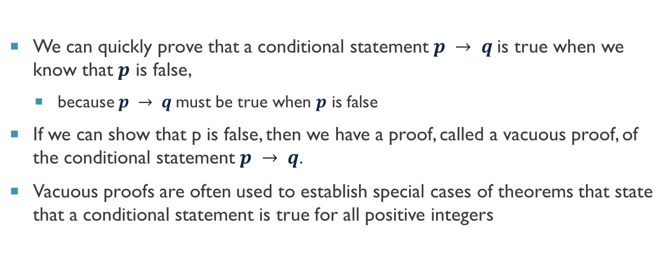
Vacuous or Trivial Proof
We can quickly prove that a conditional statement $p → q$is true when we know that $p$ is false,
because $p → q$must be true when $p$ is false
If we can show that p is false, then we have a proof, called a vacuous proof, of the conditional statement $p → q$.
Vacuous proofs are often used to establish special cases of theorems that state that a conditional statement is true for all positive integers
$$p$$ | $$q$$ | $$p→q$$
$$T$$ | $$T$$ | $$T$$
$$T$$ | $$F$$ | $$F$$
$$F$$ | $$T$$ | $$T$$
$$F$$ | $$F$$ | $$T$$

Slide 13
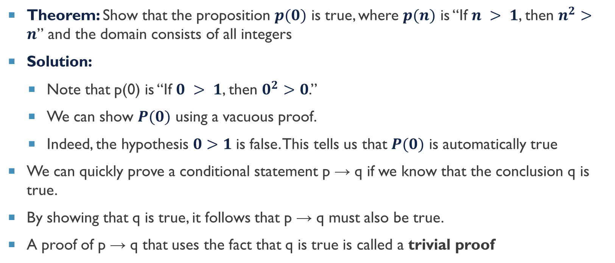
Example – Trivial proof
Theorem: Show that the proposition $p(0)$ is true, where $p(n)$ is “If $n > 1$, then $n^{2}>n$” and the domain consists of all integers
Solution:
Note that p(0) is “If $0 > 1$, then $0^{2}>0$.”
We can show $P(0)$ using a vacuous proof.
Indeed, the hypothesis $0>1$is false. This tells us that $P(0)$ is automatically true
We can quickly prove a conditional statement p → q if we know that the conclusion q is true.
By showing that q is true, it follows that p → q must also be true.
A proof of p → q that uses the fact that q is true is called a trivial proof

Slide 14
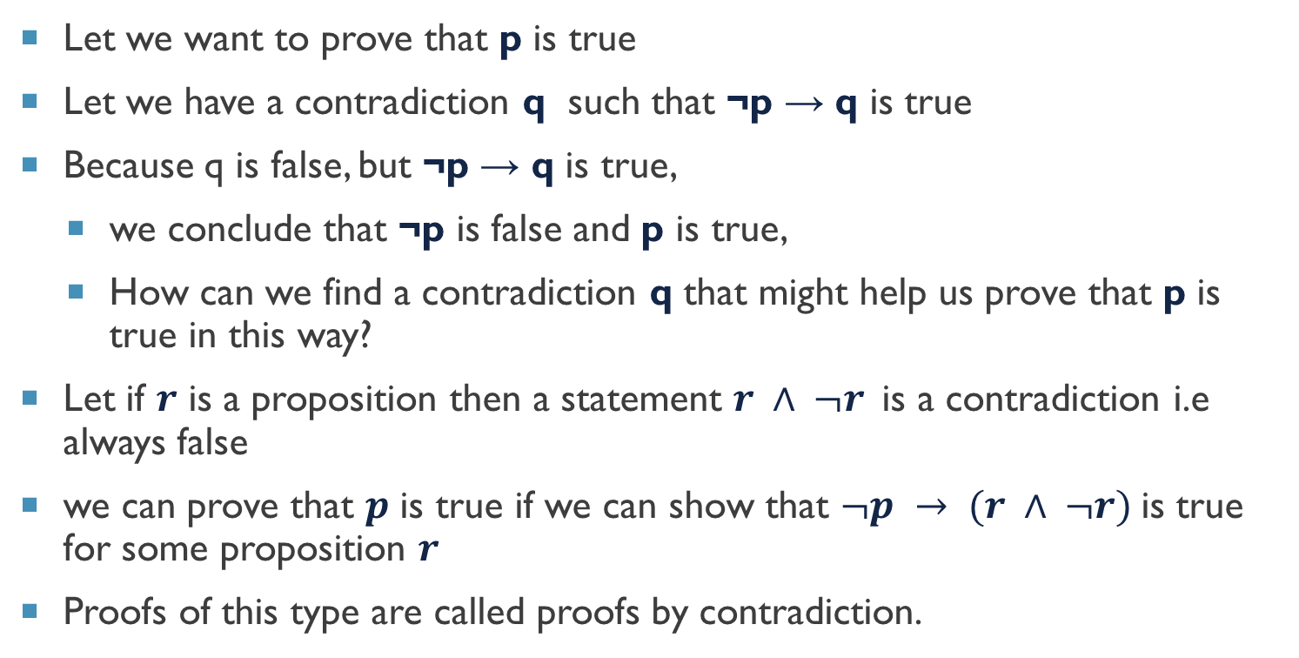
Proof by contradiction
Let we want to prove that p is true
Let we have a contradiction q such that ¬p → q is true
Because q is false, but ¬p → q is true,
we conclude that ¬p is false and p is true,
How can we find a contradiction q that might help us prove that p is true in this way?
Let if $r$ is a proposition then a statement $r ∧ ¬r$is a contradiction i.e always false
we can prove that $p$ is true if we can show that $¬p → (r ∧ ¬r)$is true for some proposition $r$
Proofs of this type are called proofs by contradiction.
$$p$$ | $$q$$ | $$p→q$$
$$T$$ | $$T$$ | $$T$$
$$T$$ | $$F$$ | $$F$$
$$F$$ | $$T$$ | $$T$$
$$F$$ | $$F$$ | $$T$$

Slide 15
Example – Proof by contradiction
Theorem: Show that at least four of any 22 days must fall on the same day of the week
Proof:
Let p = At least four of 22 chosen days fall on the same day of the week
Suppose that ¬p is true i.e. at most three (7-4) of the 22 days fall on the same day of the week
This implies that at most 21 days could have been chosen
This contradicts the premise that we have 22 days under consideration
That is, if r is the statement that 22 days are chosen, then we have shown that ¬p → (r ∧ ¬r)
Consequently, we know that p is true.
We have proved that at least four of 22 chosen days fall on the same day of the week

Slide 16
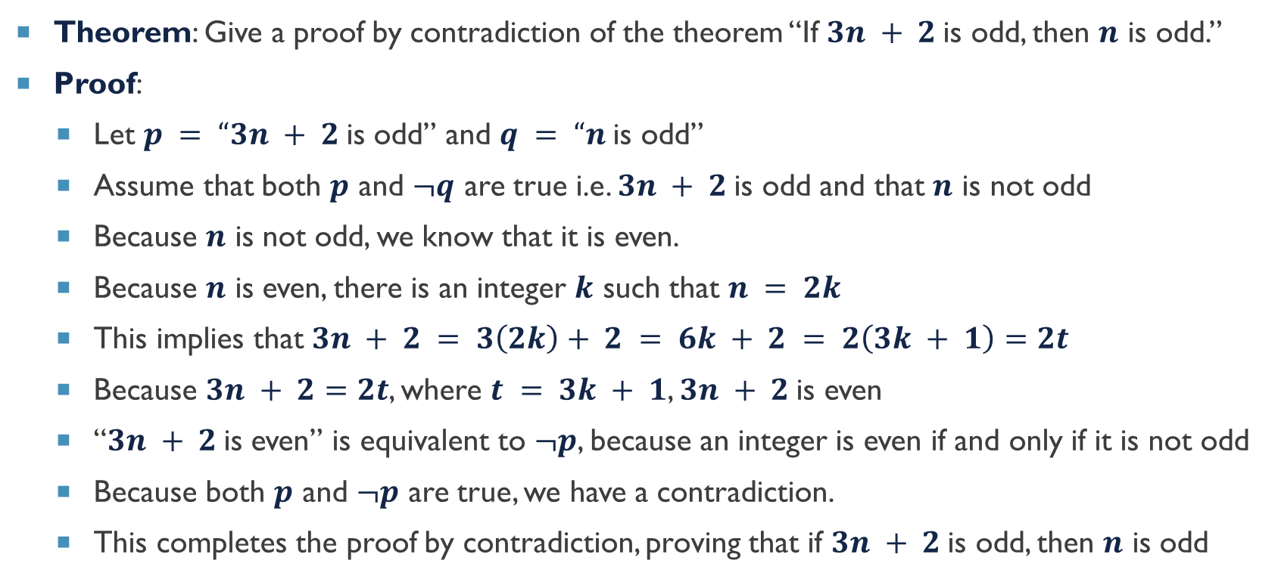
Example – Proof by contradiction
Theorem: Give a proof by contradiction of the theorem “If $3n + 2$is odd, then $n$ is odd.”
Proof:
Let $p = “3n + 2$is odd” and $q = “n$is odd”
Assume that both $p$ and $¬q$ are true i.e. $3n + 2$is odd and that $n$ is not odd
Because $n$ is not odd, we know that it is even.
Because $n$ is even, there is an integer $k$ such that $n = 2k$
This implies that $3n + 2 = 3\left(2k\right)+ 2 = 6k + 2 = 2\left(3k + 1\right)=2t$
Because $3n + 2=$ $2t$, where $t = 3k + 1$, $3n + 2$is even
“$3n + 2$is even” is equivalent to $¬p$, because an integer is even if and only if it is not odd
Because both $p$ and $¬p$ are true, we have a contradiction.
This completes the proof by contradiction, proving that if $3n + 2$is odd, then $n$ is odd

Slide 17
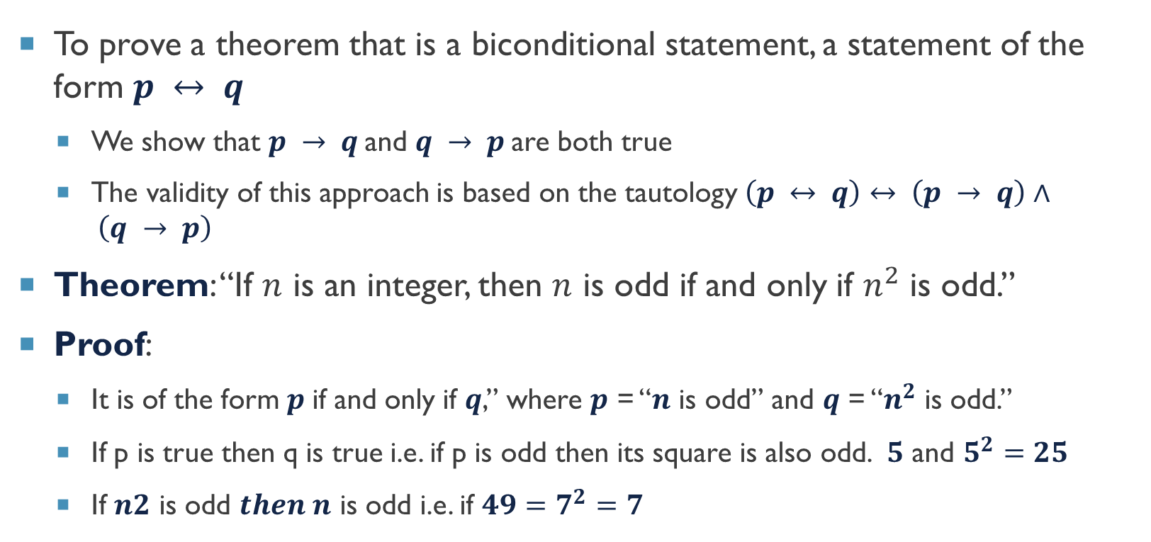
Proof by equivalence
To prove a theorem that is a biconditional statement, a statement of the form $p ↔ q$
We show that $p → q$and $q → p$are both true
The validity of this approach is based on the tautology $\left(p ↔ q\right)↔ \left(p → q\right)∧ \left(q → p\right)$
Theorem: “If $n$ is an integer, then $n$ is odd if and only if $n^{2}$ is odd.”
Proof:
It is of the form $p$ if and only if $q$,” where $p$ = “$n$ is odd” and $q$ = “$n^{2}$ is odd.”
If p is true then q is true i.e. if p is odd then its square is also odd. $5$ and $5^{2}=25$
If $n2$ is odd $then n$ is odd i.e. if $49=7^{2}=7$

Slide 18
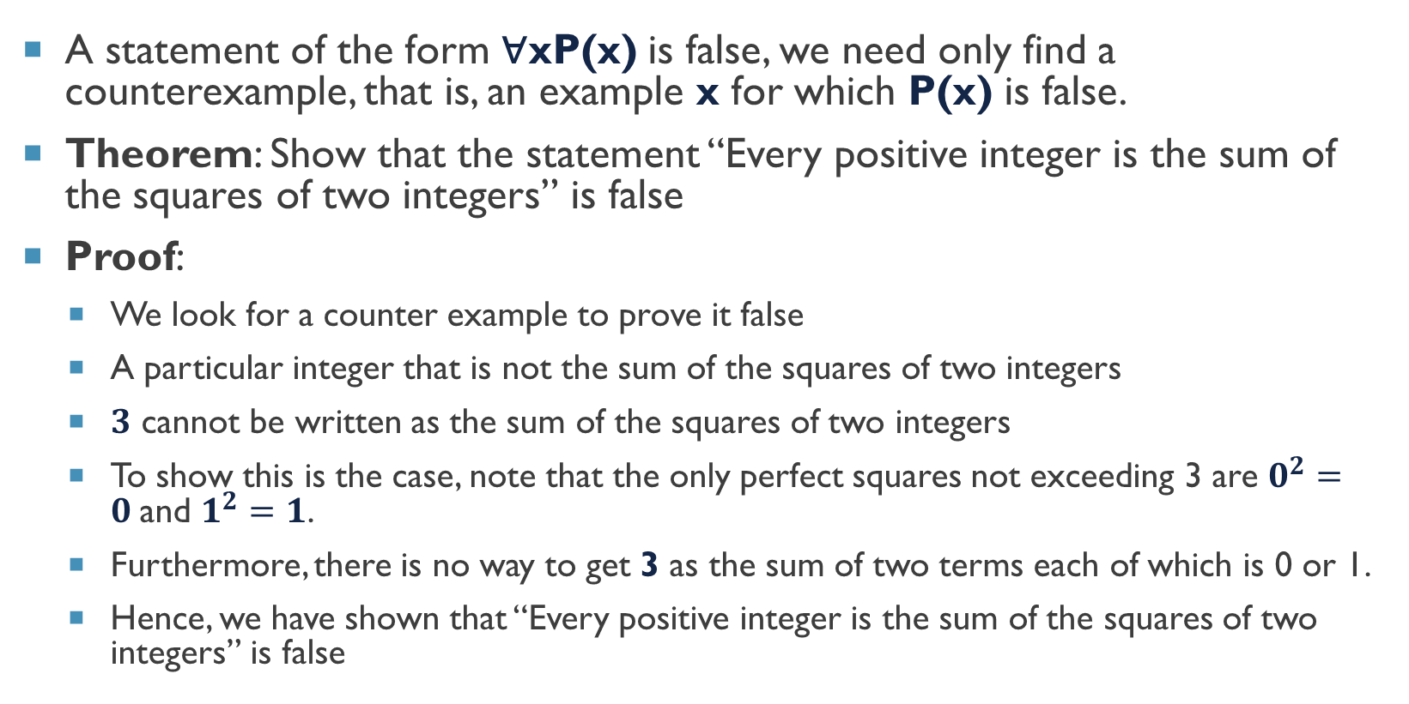
Proof by counter examples
A statement of the form ∀xP(x) is false, we need only find a counterexample, that is, an example x for which P(x) is false.
Theorem: Show that the statement “Every positive integer is the sum of the squares of two integers” is false
Proof:
We look for a counter example to prove it false
A particular integer that is not the sum of the squares of two integers
$3$ cannot be written as the sum of the squares of two integers
To show this is the case, note that the only perfect squares not exceeding 3 are $0^{2}=0$and $1^{2}=1$.
Furthermore, there is no way to get 3 as the sum of two terms each of which is 0 or 1.
Hence, we have shown that “Every positive integer is the sum of the squares of two integers” is false

Slide 19
Mistakes in proofs
There are many common errors we make in constructing mathematical proofs.
Most common errors are related to arithmetic and basic algebra
Even professional mathematicians make such errors, especially when working with complicated formulae
Whenever you use such computations you should check them as carefully as possible
Each step of a mathematical proof needs to be correct and the conclusion needs to follow logically from the steps that precede it.
Many mistakes result from the introduction of steps that do not logically follow from those that precede it

Slide 20
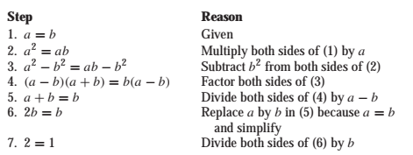
Example – error in proofs
Theorem: What is wrong with this famous supposed “proof” that 1 = 2?
Error:
Every step is valid except step 5
The error is that a-b=0 and we cant divide with 0.
Proof:
Let a and b are two equal positive integers

Slide 21
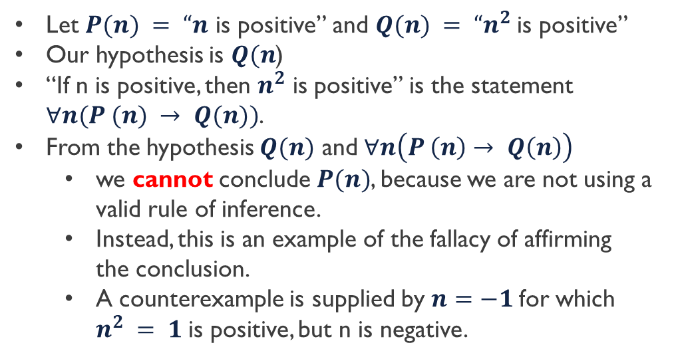
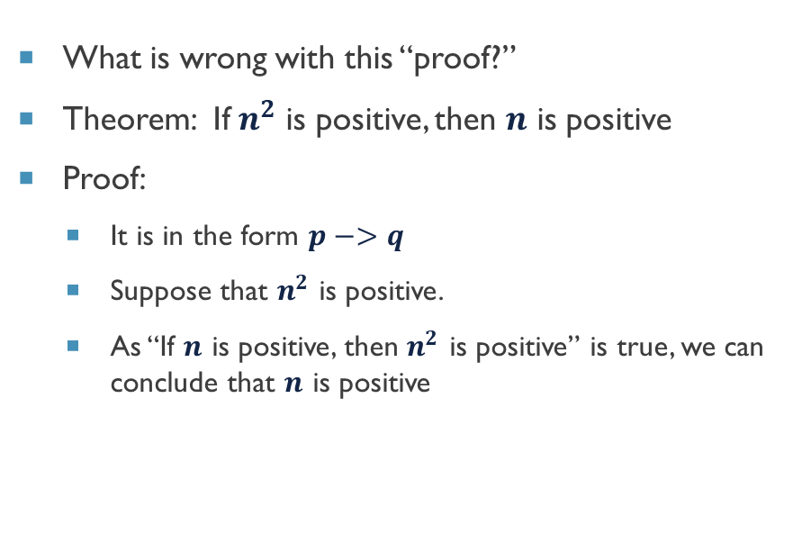
Example – Error in proof
What is wrong with this “proof?”
Theorem: If $n^{2}$ is positive, then $n$ is positive
Proof:
It is in the form $p−>q$
Suppose that $n^{2}$ is positive.
As “If $n$ is positive, then $n^{2}$ is positive” is true, we can conclude that $n$ is positive
Let $P(n) = “n$ is positive” and $Q(n) = “n^{2}$is positive”
Our hypothesis is $Q(n$)
“If n is positive, then $n^{2}$ is positive” is the statement $∀n(P (n) → Q(n))$.
From the hypothesis $Q(n)$ and $∀n\left(P \left(n\right)→ Q\left(n\right)\right)$
we cannot conclude $P(n)$, because we are not using a valid rule of inference.
Instead, this is an example of the fallacy of affirming the conclusion.
A counterexample is supplied by $n=−1$for which $n^{2} = 1$is positive, but n is negative.

Slide 22



Thanks for watching
Dr. Sajid Iqbal
Assistant Professor
Department of Computer Science
Bahauddin Zakariya University, Multan
sajidiqbal.pk@gmail.com
https://github.com/sajjo79/DiscreteMathematics
Allah Hafiz
COMEDXD

